Slide 1

Preparing for Government Contracts and Grants:
Calculating your true, allowable indirect cost rate:
What you need to know and why you might want to do it

Slide 2
Background
“Conventional wisdom on nonprofit indirect costs is beginning to reach alignment with what for-profit businesses have known all along: continually spending less on indirect costs erodes efficiency and effectiveness, preventing organizations from producing better and lasting outcomes. Contracts and grants that fail to cover indirect costs actually reduce a charitable nonprofit’s effectiveness and efficiency.”
–National Council of Nonprofits, Investing for Impact: Indirect Costs are Essential for Success, September 2013
Notes:
Why this is important for all of us to advocate for our true costs in this process. We’re all in this together and it’s equity issue.

Slide 3
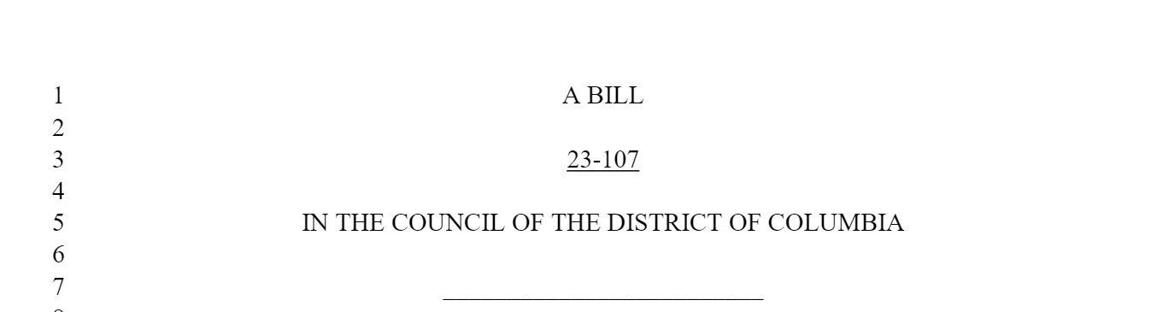
Overview of the Nonprofit Fair Compensation Law
Bottom line: DC agencies can no longer arbitrarily limit overhead or administrative or indirect costs on all grants and contracts!
If you have a federally approved NICRA – you get it!
If you don’t have a NICRA – there are now 4 ways you can justify an indirect cost rate on a DC contract or grant. This is effective for contracts/grants under $1 million Oct. 1, 2021.
Notes:
This law is being implemented in stages and then describe all the stages. The big picture of this initiative and the law. To create an equitable situation for all nonprofits across all agencies.

Slide 4
DC Contracts and Grants Managers must accept one of the following from you…
In submitting a budget for a contract or grant, for Indirect or Administrative Costs an organization may…
take a standard 10% de minimus rate of all direct costs
negotiate a new percentage indirect cost rate with the District grant/contract-awarding agency (Regulations on this are coming from the Assistant City Administor’s Office – stay tuned!).
use a previously negotiated rate (negotiated within the last two years) with a different DC government agency.
engage a Certified Public Accountant (CPA) to develop a percentage rate and base amount based on the organization’s audited financial statements from the immediately preceding fiscal year, pursuant to the OMB guidance, and certified in writing by the CPA. This option supports nonprofits who seek professional assistance in developing their indirect cost rate.
Notes:
This is what is going to be covered in the training to follow this.

Slide 5
Learning Outcomes for this Session –
Participants will…
Understand fundamentals of indirect rate calculation under OMB Uniform Guidance
Understand “likely” definition of “certified” and how to get your rate certified in writing
Understand economics of this process, what it involves, potential costs, and determine it’s worth for your organization
Learn basics of negotiation with your contract or grants officer

Slide 6


Advantages of Indirect Rates
Notes:
MEL

Slide 7
Advantages of Using Indirect Rates
Recover – Goal is to recover all administrative costs: executive, finance, HR, IT, procurement, general admin
Sustainability – Recovering only direct costs leads to possible “going-concern” issues
Permitted on direct funded awards – Direct prime grants with most Federal agencies permits full recovery of indirect
DC and MD laws have changed – Nonprofit Fair Compensation Act allows recovery of Federal NICRA, negotiation of rate
Higher recovery than the 10% De Minimis Rate (DMR) – The DMR permits only a 10% fixed rate on MTDC base
Easy to compute- Indirect rates are fractions: numerator / denominator, ratio applied to direct grant cost
Fractional methodology vs. specific identification – Group your indirect cost over denominator in lieu of listing items
Accepted methodology – Certain methodologies are accepted by the government in the Uniform Guidance 2 CFR 200
Notes:
July 26, 2018
Senate Bill 1045, enacted by the 2018 General Assembly, is a modest step to help the sustainability of our smaller nonprofit service organizations, and to streamline and simplify the treatment of indirect costs across state agencies and other intermediaries (or ‘pass
though
entities’), similar to the new OMB Uniform Guidance at the federal level. Under SB 1045 state agencies or intermediaries would be using the same definitions and guidelines that they have been required to use for at least three years for most federal funds they handle. Senate Bill 1045 was sponsored by Senator Cheryl Kagan of Montgomery County and supported by Maryland Nonprofits with help from numerous service organizations and nonprofit officials. The legislation takes effect on October 1, 2018.
Why was this necessary?
Sustaining a healthy community of willing qualified providers is crucial for state programs – consistent underfunding seriously threatens that. A significant number of nonprofits, some believe a majority, have less than 30 days operating reserves. Underfunding by not allowing indirect costs, coupled with administrative burdens and often payment delays are serious threats. But many state service contract or grants still limit or disallow the nonprofit providers’ actual indirect costs of administering the grants or contracts
What does Senate Bill 1045 do?
It assures
that nonprofit service providers
who lack the capacity (because of their limited size, staff, or other resources) to establish a formal rate for reimbursement of these actual costs of providing services to our constituents and communities, are allowed to recover what current federal rules characterize as a ‘de minimis’ amount, at least 10% of the “modified total direct costs” of the services they provide. If providers have an approved federal indirect cost rate it would apply that rate.

Slide 8

How to Calculate Indirect Rates
Notes:
MEL

Slide 9
Types of Indirect Rates
Indirect rates are synonymous with:
Burdens, loading, overhead - all equates to “administrative costs”
Different Types of Indirect Costs:
Fringe
2. a) General & Administrative (G&A or M&G - Indirect, Management & General from IRS Form 990)
2. b) F&A: Facilities & Administrative rates from the OMB Uniform Guidance 2 CFR 200

Slide 10
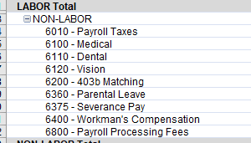
Definition of Fringe
What do we typically see in a “Fringe benefit pool?”

Slide 11
Example of how to Calculate a fringe rate
In the example on the next slide, please note:
  Fringe costs includes just three things -- pension, medical insurance and payroll taxes -- for simplification
  Direct Labor in the example includes direct wages and paid vacation, holiday, and sick leave (this example doesn’t include M&G Labor)
For more than a handful of staff, it is impossible to directly assign the fringe costs that we defined to each person’s individual situation, so we come up with a ratio-fraction.
As a rule, Fringe expenses is then the numerator and Total Labor is the denominator to develop a % via a fraction.

Slide 12

Fringe Rate Computation Example
Numerator (Cost Pool)
Fringe Indirect Cost Pool:
$1,500 Pension +
$1,500 Medical Insurance +
$500 Payroll Tax +
$3,500 Fringe Total
Denominator (Allocation base)
Direct Labor Costs on two grants:
$2,000 Direct Labor (D/L) Grant A +
$8,000 D/L Grant B +
$10,000 Total Grant D/L* (Allocation Base)
Computing the resultant fringe rate
$3,500/$10,000 = 35%
*M&G indirect Labor not included in this example.

Slide 13
Example of applying the Fringe Rate to the Grants…
Grant A:
$2,000 Direct Labor +
$700 Fringe ($2,000 D/L x 35% fringe rate) +
$1,400 non-labor direct costs +
$4,100 Total cost for Grant A
Grant B:
$8,000 Direct Labor +
$2,800 Fringe ($8,000 D/L x 35% fringe rate) +
$9,600 non-labor direct costs +
$20,400 Total cost for Grant B
Notes:
Paul where do the other ODCs come from? What are those? Are they M&G? Or something else?

Slide 14
Example of calculating an indirect M&G Rate
Numerator (A)
Add your general administrative costs -- Executive director’s office, Finance, HR, IT, Purchasing, Facility Mgmt. Office Space, Utilities, Audits, Insurance.
In this example, let’s say they add up to
$150,000 in M&G (A)
Denominator (B)
And you have $900,000 in general operating expenses funding programs, fundraising, membership, promotion, P/R, lobbying expenses + you have
$100,000 direct costs of a DC grant
$1,000,000 direct base costs (B)
Resultant rate: Fractional relationship between (A) general fund (M&G) and (B) Programs (DBC) $150,000/$1,000,000 = 15% is M&G rate
Notes:
Is the

Slide 15
Application of the M&G Rate to the DC Grant
Total cost definition:
$100,000 direct costs of DC grant in prior example
$ 15,000 applied indirect (15% M&G rate x $100,000 ) +
$115,000 = total value of grant
Total cost definition = the sum of direct and indirect costs allocable to a grant less off-sets such as rental income, credits, refunds, rebates)

Slide 16
Putting it all together - Indirect Wrap Rate
Indirect Wrap Rate means the two rates wrapped together:
I have a Fringe rate of 35% and I have an M&G rate of 15%,
  Fringe (1.35) x M&G (1.15) = 1.5525
  For every direct labor $1.00 spent, there will be an additional cost of 55¢ in burden cost.
  This is called full cost recovery (your true costs). This is the formula you use so you don’t underprice!

Slide 17
Mandatory Requirements for M&G Rate
Your M&G rate must relate to a 12-month fiscal period/like your financial statements
Must benefit the entire organization as a whole. You can’t develop a rate for just one program or one grant

Slide 18
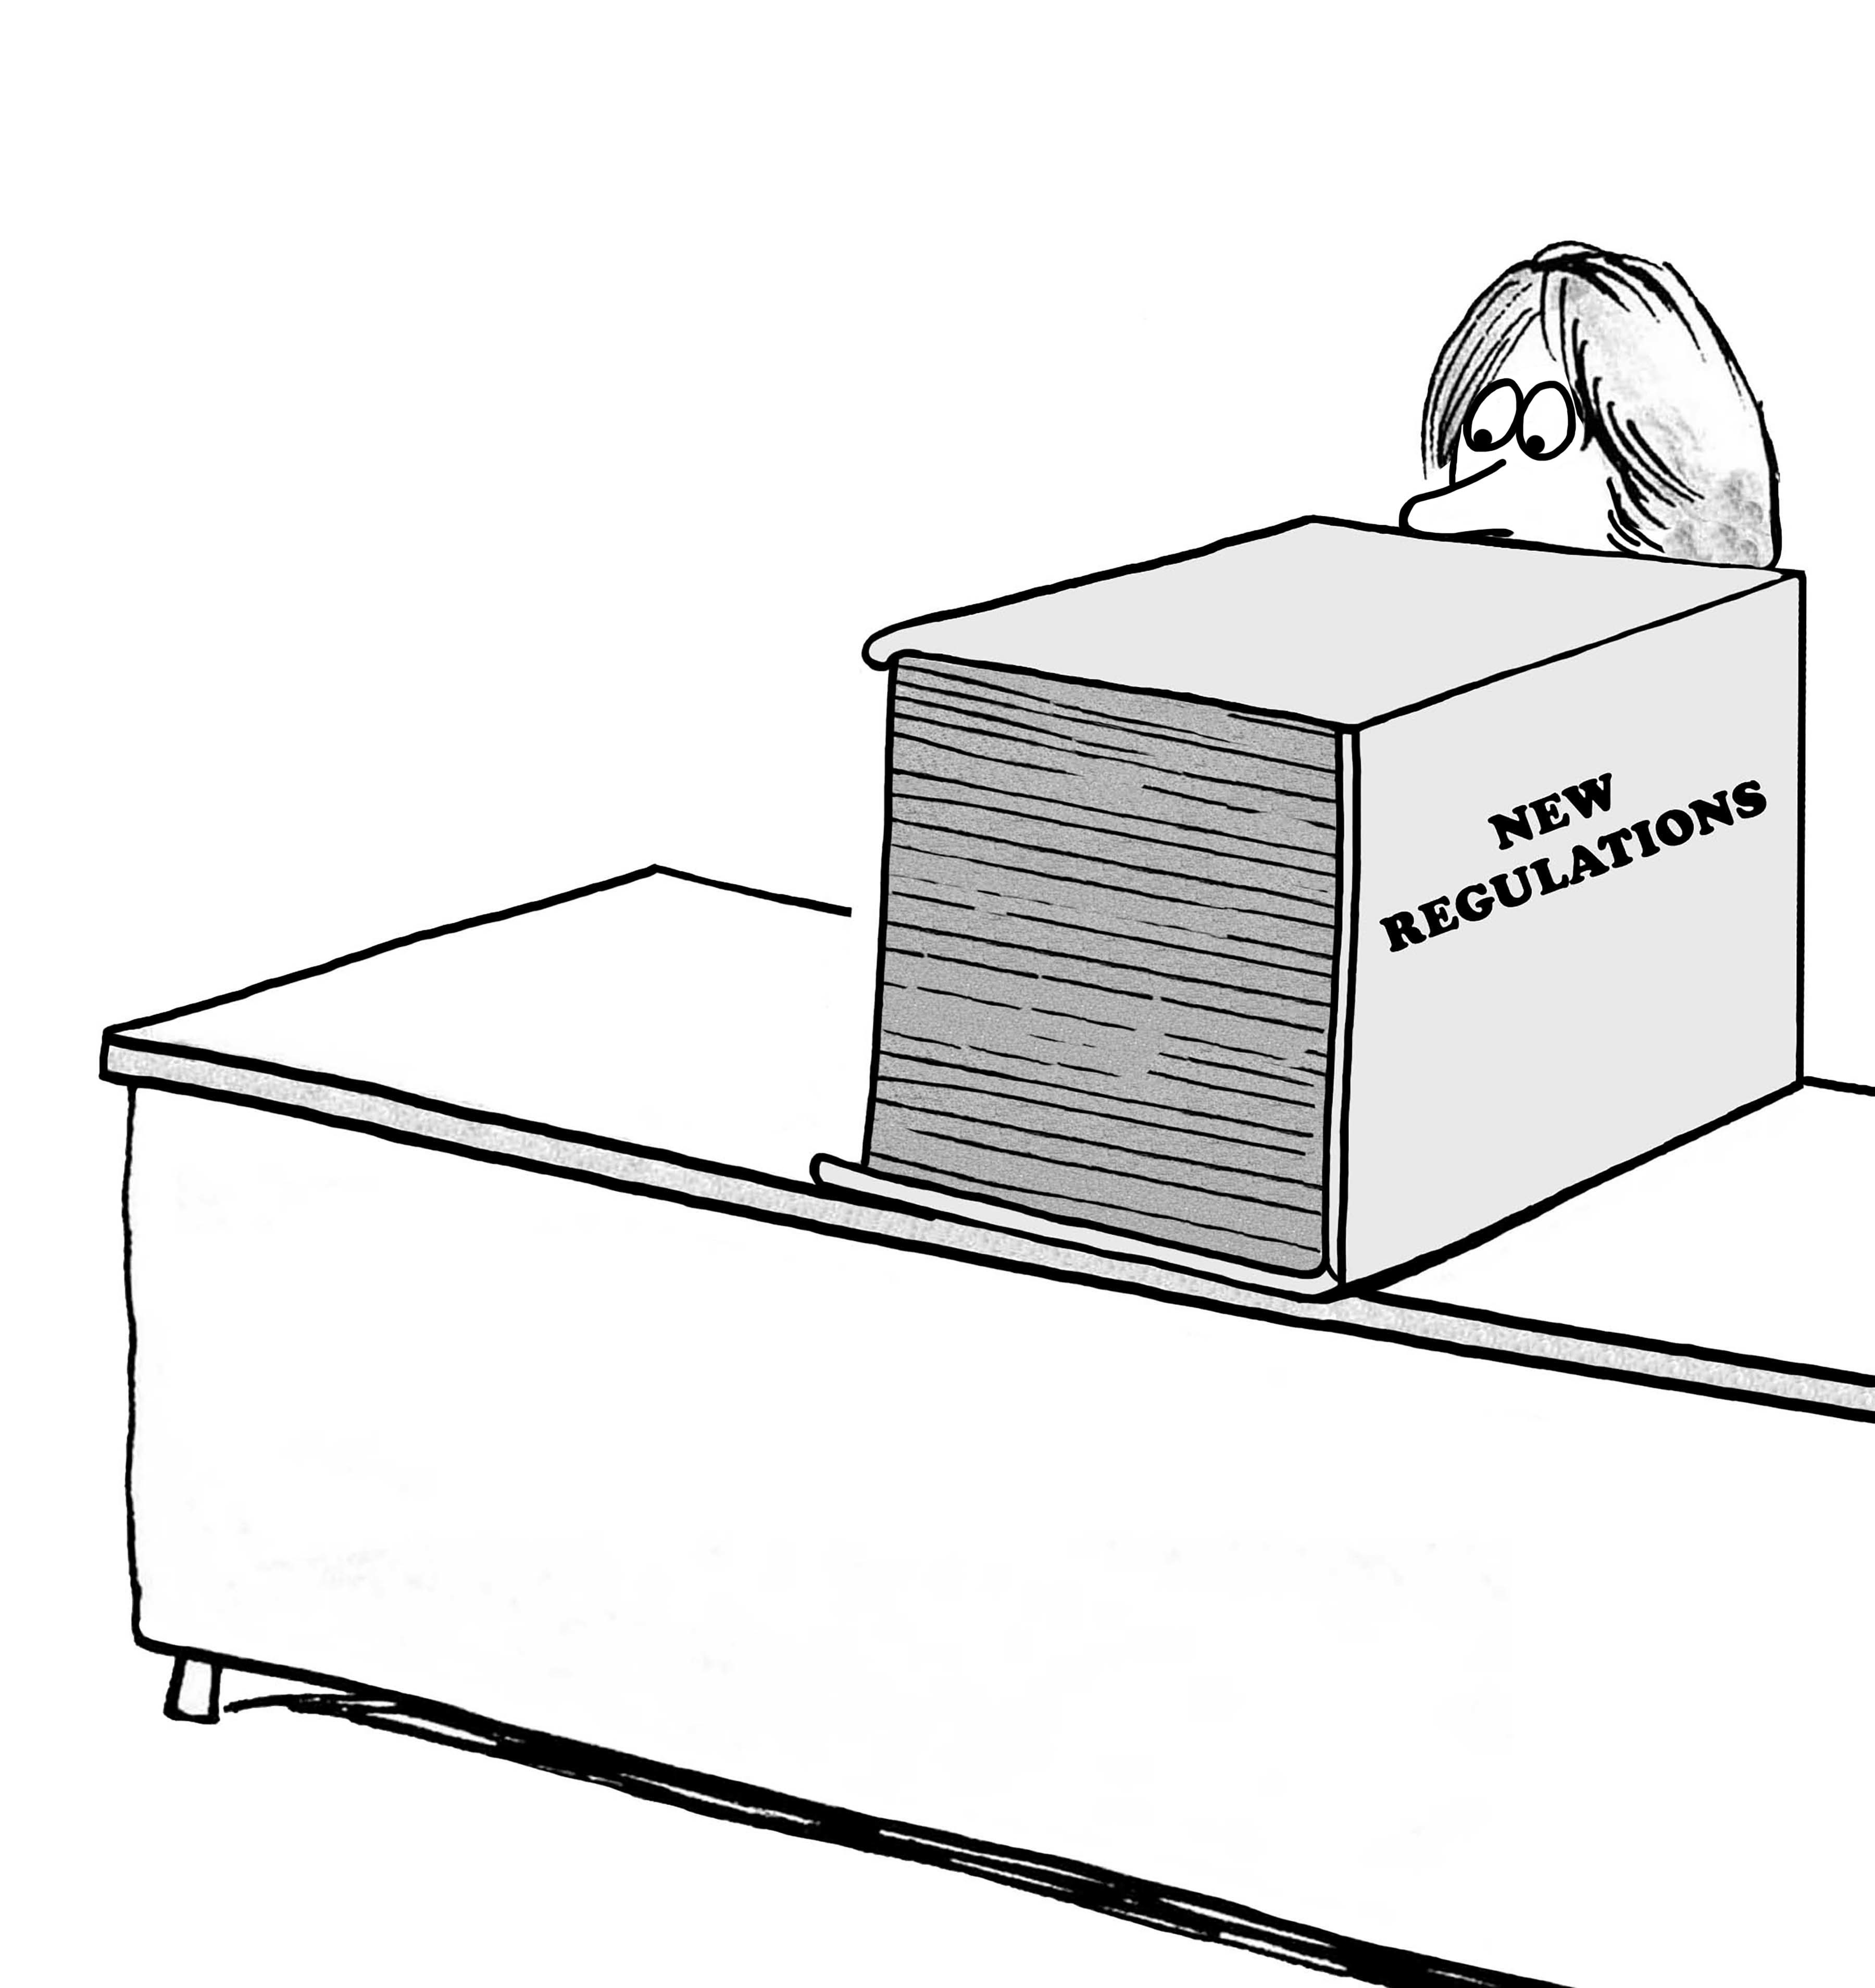
The OMB Rules
2 CFR 200 & 45 CFR 75
Subpart E, Cost Principles §400

Slide 19
10% De Minimis Rate (DMR)
Per 2 CFR 200.414(f)
Applies to nonprofits who never received a negotiated indirect rate or do not have a current negotiated indirect rate (would we use the term NICRA here?)
Is charged on a modified total of the direct cost base (implications of direct cost adjustments that the government can take out)
  Fixed 10% to be multiplied to the reduced direct cost denominator
May be used indefinitely until an indirect rate is negotiated (a NICRA?)
De Minimus Rate is not adjusted by any PPP loan forgiveness, i.e. credits clause 2 CFR 200.406 (only if you had a negotiated rate)
Notes:
This applies to both the DC and MD laws that reference this
Reasons why you don’t want to use the DMR – first of all you only get 10 %
You may actually need to remove some of your direct costs from the calculation of your 10 % (rent, sub-awards)

Slide 20
Pass-Through Entity (DC or MD) Responsibilities
2 CFR 200.332(4)
If you are receiving federal funds through a pass-through entity, by law you should have been provided your negotiated rate (if you had one), the DMR, or an alternative. Here are the federal rules…
Sub-Recipients working with Pass-Through Entities (PTE):
PTE must accept sub’s NICRA, if no NICRA…
  PTE must determine an appropriate rate in collaboration with the sub-recipient which is either:
  (2.) Negotiation or (3.) DMR
If negotiation
  The negotiated rate can be predicated on a prior negotiated rate with a different PTE and same sub
  If predicated on prior negotiated rate, the current PTE is not required to collect information on the prior negotiated rate but may elect to do so.
Notes:
Question about nonprofit pass-throughs of federal funding (i.e. The Community Partnership – nonprofit intermediary, not a government agency) does this apply? DC Bar Foundation is another intermediary that is not giving full indirect costs.

Slide 21

What is a “Certified” Indirect Rate
Notes:
MEL

Slide 22
What does “Certified in Writing” by CPA mean?
DC Council Bill 23-407 (4) – DC “Nonprofit Fair Compensation Act of 2020”
According to the DC law, the 4th way you can negotiate your indirect rate :
  (4) “As calculated with a percentage rate and base amount, determined by a certified public accountant using the nonprofit organization’s audited financial statements from the immediately preceding fiscal year, pursuant to the OMB Uniform Guidance, and certified in writing by the certified public accountant.”
The word “examination” was not included so you don’t need an audit of the indirect rate.
All it means is you present the signature of a CPA on letterhead certifying your rate “true and correct.” The CPA may add additional qualifications.

Slide 23
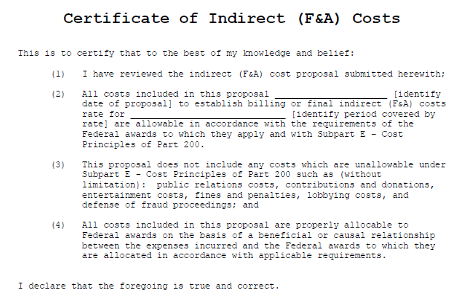
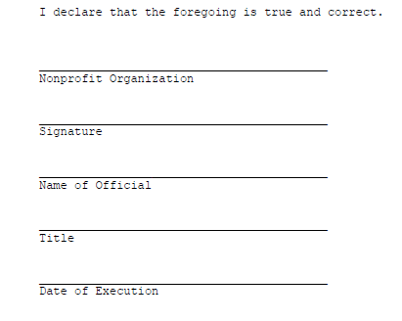
Federal Template for a NICRA
Nonprofit Certifies not CPA…

Slide 24

What are the economics? What does it cost?
Notes:
MEL

Slide 25
What are the economics of a negotiated rate?
Not every public accounting firm or outsourced bookkeeper has the expertise to compute a negotiated rate
So where do you go?
Do your research, go to other nonprofit leaders that have one. Go to Greater Washington Society of CPAs (that’s for DC) or MD Association of CPAs – someone there may know who has this expertise.
What will it cost? There will be a fee (depending on your size and quality of records).
Weigh that with being able to get higher cost recovery (difference between your 10 % DMR and the negotiated rate with the state multiplied by the value of your grant or contract award/s.

Slide 26
Things that might impact your fee for preparing your rate
Quality of your outsourced accountant and related books and records
  If they are really good they can be trained to do it for you
Reconciliation between your books and the audit
Size of organization in terms of revenue
Your general ledger account structure
  Is it structured to track direct and indirect costs?
If the grant value is too small (like $20,000), it doesn’t make sense - just stick with the DMR (de minimus rate)
Notes:
Give some examples of what it could be – a range

Slide 27
Q and A and Next steps
Resources
https://blog.blackbaud.com/making-a-case-for-calculating-your-nonprofits-indirect-costs/
https://www.nonprofitnicra.org/?gclid=Cj0KCQjwlN6wBhCcARIsAKZvD5i8L3OPtsVdmpCQs2hoKlwkZV3KD9fgqDiAyZ2IFbu1kcrEUBJGDkcaAqXsEALw_wcB
https://fairchance.box.com/s/dfdyn8u5e9hfmpk4cm3g4po4tdgu3ne5
Almost every federal agency has a guide calculating nonprofit indirect cost rates

